Slide 1

Tier Splitting using Static Analysis
Presenter ： Xinran AI
Promoter：Prof. Dr. Coen De Roover
Guidance by: Laure Philips
Jens Nicolay
Notes:
Hello, everybody. My name is Yu Tian. I am going to present my thesis，the title of my thesis is “browsing and interacting with internet of things via Augmented Reality technologies.

Slide 2
Index
Problem State
Background Knowledge
Program slicing
Abstract Interpreter
Case study of slicing on State graph
Implementation of JipdaSlicer
Validation
Conclusion
Contribution
Future work
2

Slide 3
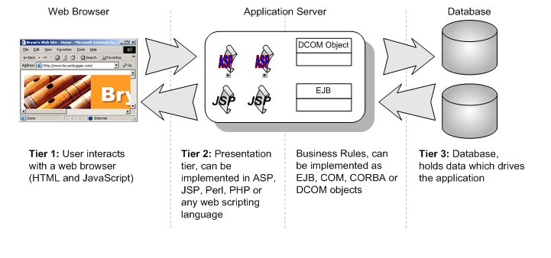
Problem State
Enable web applications with more interactive features is increasing complexity of web application development in typical three tier architecture.
3

Slide 4


Problem State
Solution: Tierless program language
Good enough?
Investment of novel language
Effect to familiar with a new programming language
Effort on annotate tier information
Error-prone
HOP
4

Slide 5



Problem State
Solution: Tierless program language
Existing technologies such as JavaScript with distributed features to cater for tier splitting seems more beneficial.
https://soft.vub.ac.be/~lphilips/jspdg/stip/stip-web/stip.html
HOP
5

Slide 6
Problem State
A tierless JavaScript code generator
only require annotate code with
@client and @server.
Static analysis source code based on abstract interpretation result in state graph
Construct PDG on top of state graph
Apply program slicing technique on PDG
Distribute sliced code into client tier and server tier.
6

Slide 7
Problem State
A tierless JavaScript code generator
only require annotate code with
@client and @server.
Static analysis source code based on abstract interpretation result in state graph
Construct Program Dependence Graph on top of state graph
Apply program slicing technique on PDG
Distribute sliced code into client tier and server tier.
7

Slide 8
Problem State
Motivation
Develop in a new slicing algorithm, called JipdaSlicer, which can slice on state graph directly without building any intermediate presentation.

Slide 9
Background Knowledge
Program slicing
Abstract Interpreter
9

Slide 10
Program Slicing
Weiser’s program slicing theory:
Definition:
A slice S of program P, is obtained from a specific slicing criterion denoted as a pair of value <i, V>, where i is the line number of statement in P, and V is set of variables defined or used at i.
A slice S can be obtained by deleting zero or more statements from program P. Meanwhile, P and S must behave the same with respect to <i,V>.
10

Slide 11
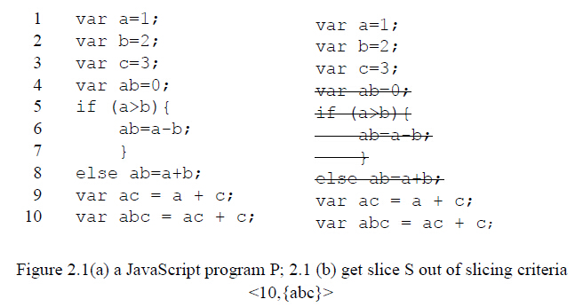
Program Slicing
Weiser’s program slicing theory:
11

Slide 12
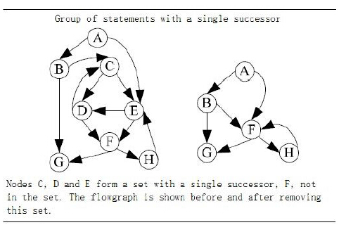
Program Slicing
Weiser’s program slicing theory:
Flow graph as a presentation of program.
Node is statement
Edge is flow relation between nodes.
12

Slide 13
Program Slicing
Slicing on Program Dependency Graph(PDG)
Data dependency in PDG
If a statement S’ use the variable defined at statement S without redefining of this variable during the execution, then statement S’ is data dependent on statement S.
Control dependency in PDG
If a statement S’ is control dependent on statement S, there will be two edges out of S, the “True” edge will lead to execute on S’, “False” edge will lead the program jump to another statement.
13

Slide 14
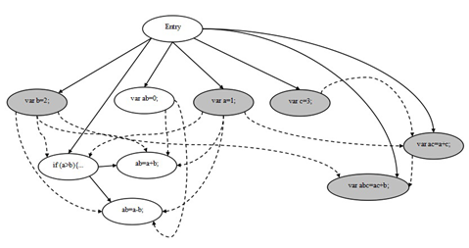
Program Slicing
Slicing on Program Dependency Graph(PDG)
Backward traversal
var a=1;
var b=2;
var c=3;
var ab=0;
if (a>b){
ab=a-b;
}
else ab=a+b;
var ac = a + c;
var abc = ac + c;
14

Slide 15
Program Slicing
State of the art of Program Slicing
Method
Backward and forward traversal
Dynamic and conditional program slicing
Application
Debugging
Testing
Software mantaince
Re-engineering
Web security
15

Slide 16
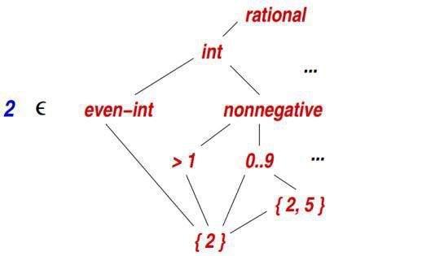
Abstract Interpreter
Abstraction is used to depict property
Syntax and semantic is abstract interpretation of program
A summary of behavior of program.
Value abstractions
16

Slide 17
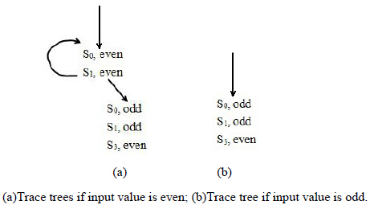
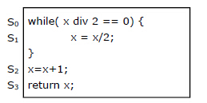
Abstract Interpreter
Static analysis based on abstract interpretation
Try to simulate the execution of program
17

Slide 18
Abstract Interpreter
CESK-machine abstract interpreter
is used to translate a source language, which defines source component, to a target language which augment source language with frame expression to specify the permission of component.
It decompose program into four components: a (C)ontrol component, a (E)nvironment, a (S)tore and a (K)ontinuation.
C: expression in functional programming
E: map a value to its address
S: map an sddress to its value
K: the continuation state of current symbol
When evaluate on atomic expression and (complex) expression
Atomic expression is return the value of expression itself
(Complex) expression is return atomic expression and the continuation in every evaluate step
18

Slide 19
Abstract Interpreter
Example of evaluation:
given a letbound expression (let ([v exp]) body)
First evaluated exp
Then bind the computation result to v, then holding the resume to body.
19

Slide 20
Case study of program slicing on state graph
20

Slide 21
Case study
Make assumption by observation
21

Slide 22
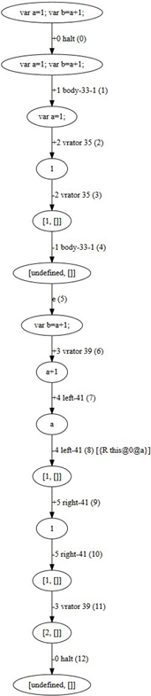
Case study
Make assumption by observation
var a=1;
var b=a+1;
Second line is data dependent on first
line.
22

Slide 23
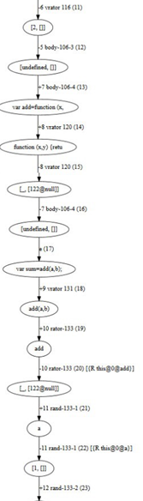
Case study
Make assumption by observation
Examine on control dependency:
Define a function sum(a,b) and call
this function in other statement.
23

Slide 24
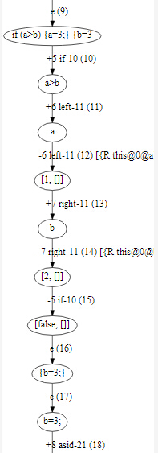
Case study
Make assumption by observation
Checking on state transition of
conditional statement.
example code:
var a = 1;
var b = 2;
if(a>b){
a=3;
}else{
b=3;
}
24

Slide 25
Case study
Three assumptions:
Directly influence statement and variable is found by matching identifiers and scope information on the edges.
Indirectly influence statement and variable is found by iteratively executing to find dependences on directly influence statement and variable we get in each stage of query.
We can replace the code in clause result from false predicates with null value.
25

Slide 26
Implementation
26

Slide 27
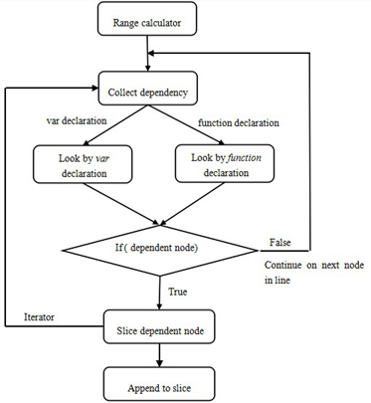
Outline
27

Slide 28
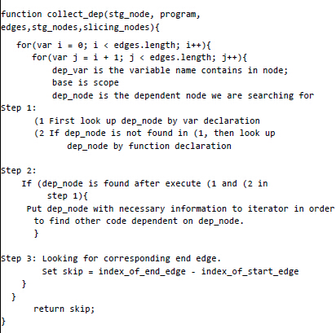
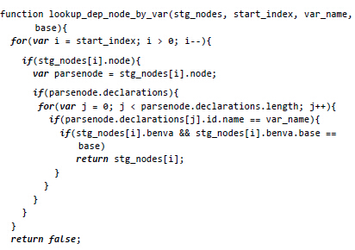
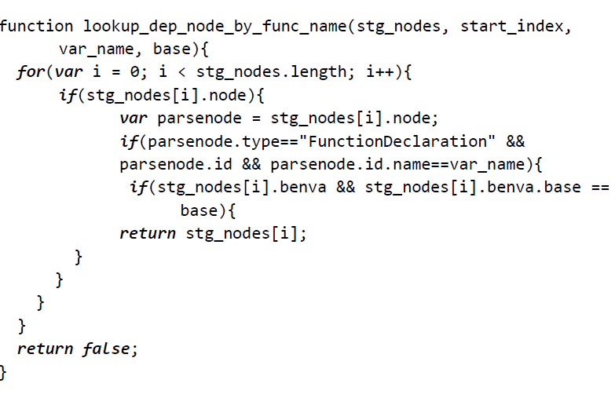
Key functions
28

Slide 29
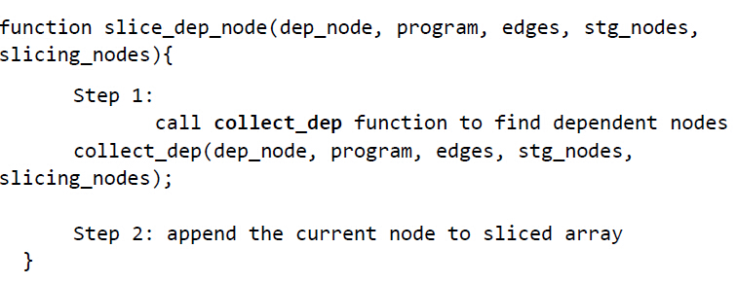
Key functions
29

Slide 30
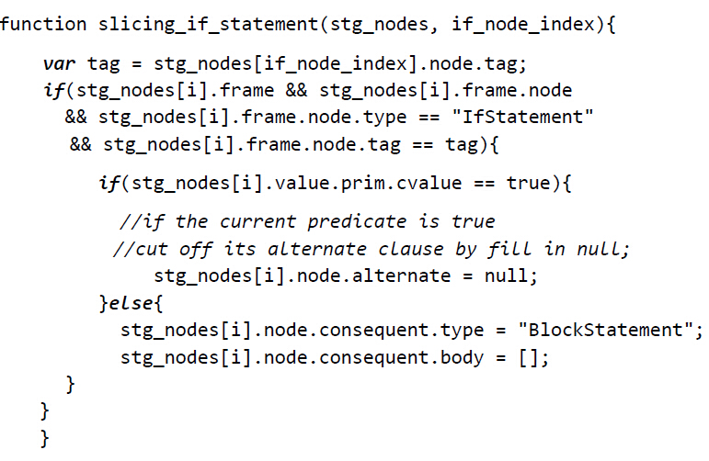
Key functions
30

Slide 31
Validation
31

Slide 32
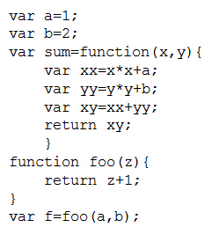
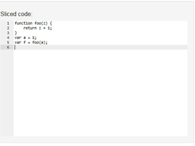
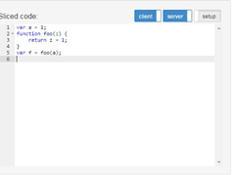
Evaluation
JipdaSlicer
Stip.js
32

Slide 33
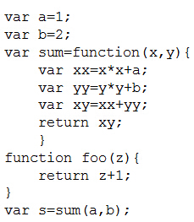
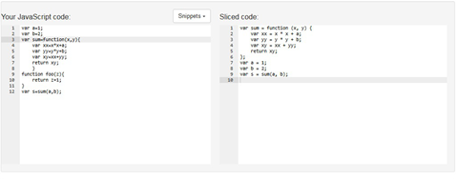
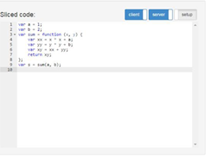
Evaluation
JipdaSlicer
Stip.js
33

Slide 34
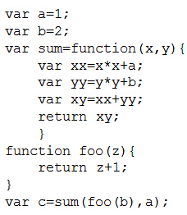
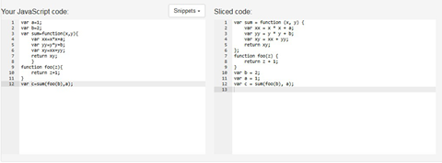
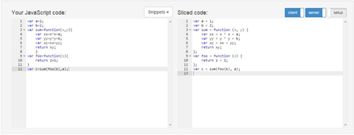
Evaluation
JipdaSlicer
Stip.js
34

Slide 35
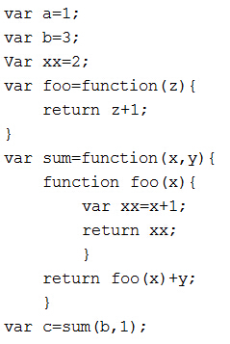
Evaluation
JipdaSlicer
35
Stip.js

Slide 36
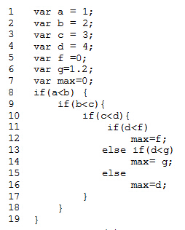
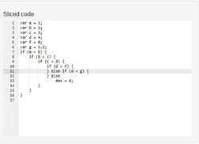
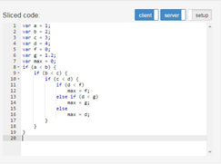
Evaluation
JipdaSlicer
36
Stip.js
Stip.js

Slide 37
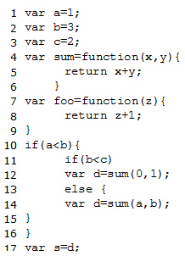
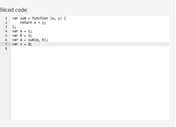
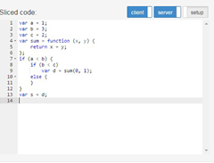
Evaluation
JipdaSlicer
37
Stip.js
Stip.js

Slide 38
Conclusion of Evaluation
The order of sliced code in JipdaSlicer is dependent on the identifiers’ position in slicing criterion.
Powerful enough to analyse control and data dependences.
Is able to maintain syntax structure of if-else statement.
38
Stip.js

Slide 39
Conclusion
39

Slide 40
Contribution
Examine if the program dependency graph is necessary to acquire a correct slice of a program.
The general pattern isolates dependencies query from analysis complexity.
Correctly reflect syntax structure of conditional statement.
40

Slide 41
Future work
Interpreter design
To process more syntax structure, such as loop statement like while, for
Distributed code
To be able to generate distributed sliced code in Node.js and Meteor.js framework.
Algorithm performance
A dynamic programming algorithm to reduce time complexity of our algorithm
41

Slide 42
Thank you!
Any Questions?
42

Slide 43
Backup slides

